Slide 1
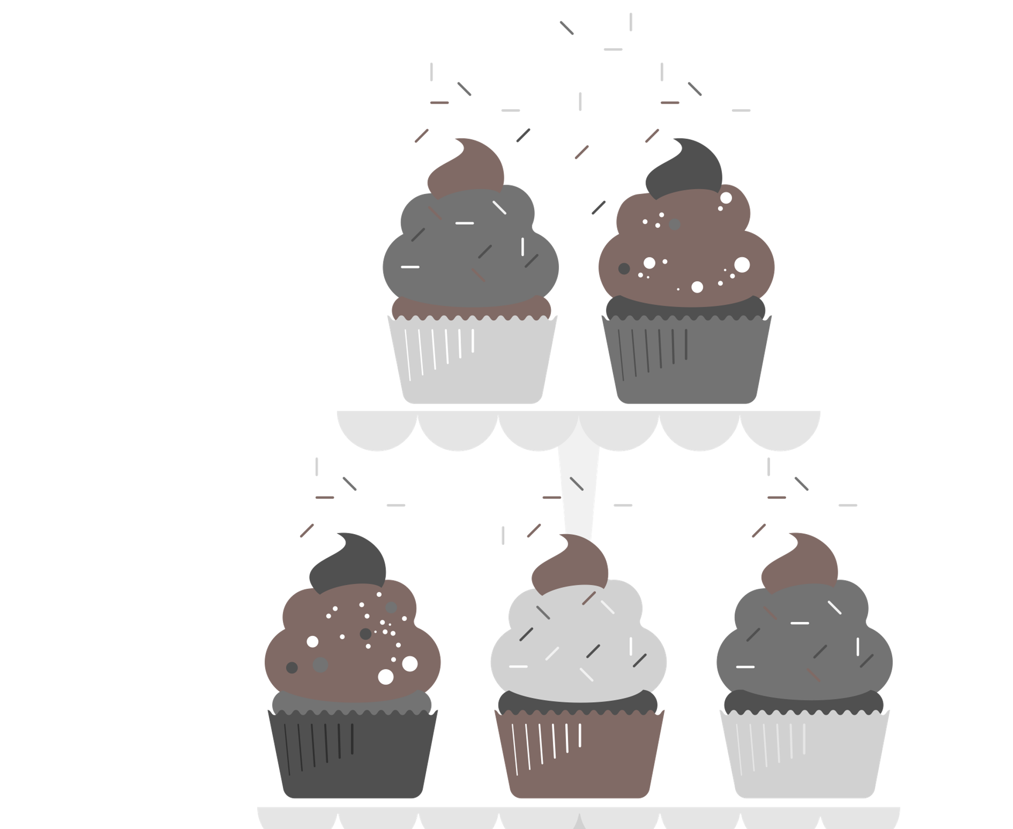
Sweet!! Or too sweet?
STAT 628 – Group #9
Niharika Chunduru
Siyan Wang
Yiyuan Li
App Link: https://niharika-chunduru.shinyapps.io/Yelp-Bakeries-Analysis/

Slide 2
The problem we wish to address
Target Sample: Bakery Business Owners in Santa Barbara
Since 2005, more than a third of the bakeries got shut down over the years
A comparative analysis study of open and closed bakeries in Santa Barbara
Helping current and new business owners identify factors impacting their business star ratings
App Link: https://niharika-chunduru.shinyapps.io/Yelp-Bakeries-Analysis/

Slide 3
DATA HANDLING
DATA SOURCES:
Business & Reviews Data from Yelp, and Average Income Data from US Census Bureau.
DATA PRE-PROCESSING:
1. Word-cloud and Aspect-Based Sentiment analysis:
Separated the reviews to closed and open bakeries reviews
Classified reviews as positive reviews (>=3.5 stars) and negative reviews (<3.5 stars).
Tokenized word reviews and identified top 5 Aspect dimensions: Food, Drinks, Service, Ambiance, and Price
2. Zip-Code Analysis:
Calculated the duration of operation of a bakery from the last posted review
Extracted and processed income datasets for each zip-code in Santa Barbara from 2011 till 2021
App Link: https://niharika-chunduru.shinyapps.io/Yelp-Bakeries-Analysis/
Notes:
We gathered business and reviews data from Yelp, and income data from the US Census Bureau.
For our sentiment analysis, we separated reviews into open and closed bakeries, and classified them into positive and negative categories. We then tokenized the words in the review and identified the top five aspects in. review.
And for the zip code analysis, we calculated the last date of operation based on their last posted review. We overlaid it with census data on averaged incomes of the county for each zip code for the last decade

Slide 4
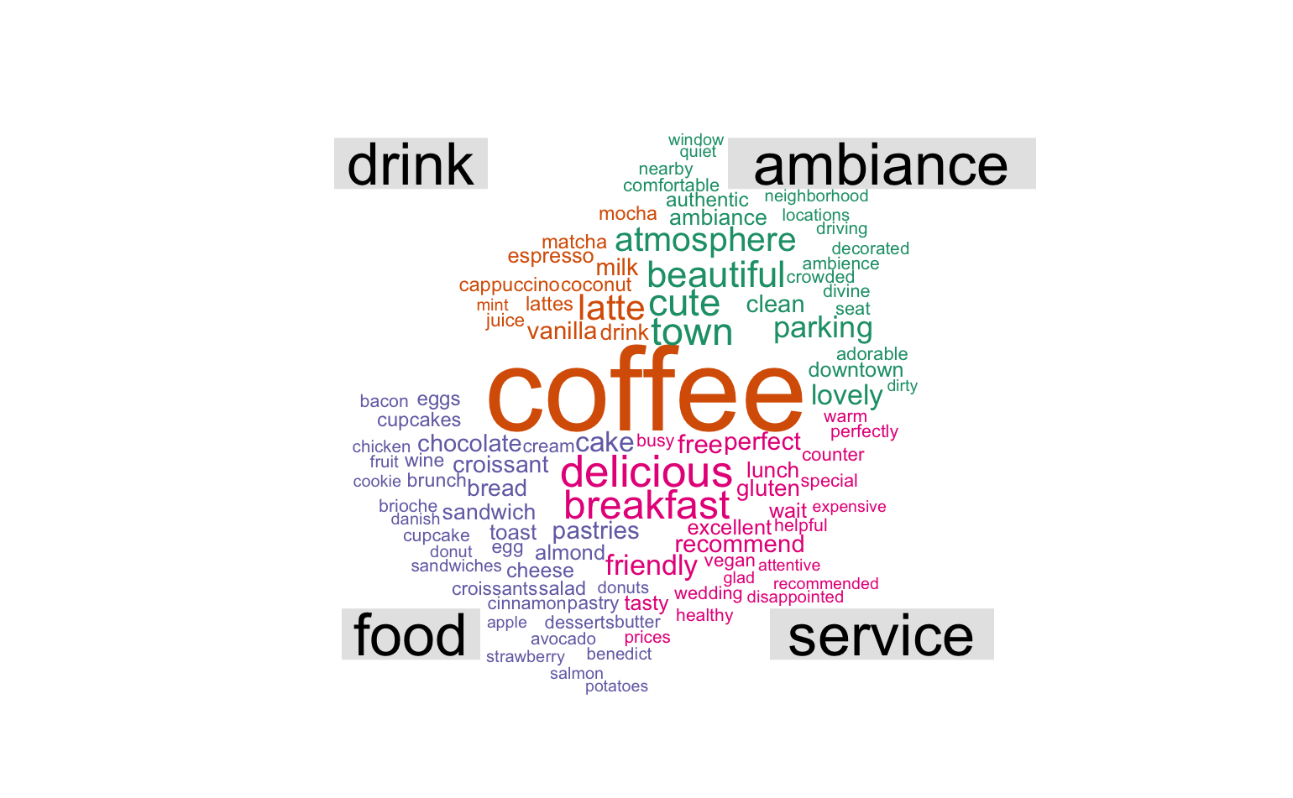
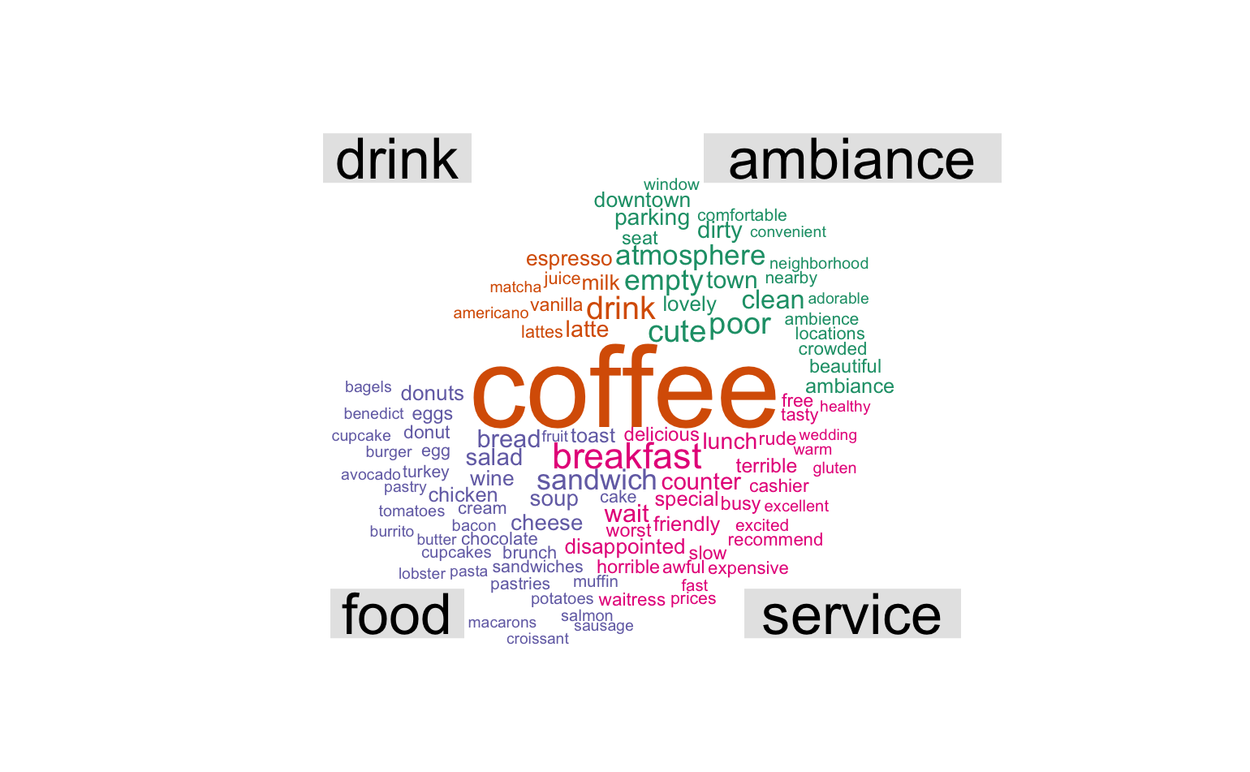
Word-cloud Analysis
Aspect | Example Words
Food | croissant | cake
Drink | coffee | latte
Ambiance | beautiful | dirty
Service | warm | awful
Word analysis based on top four aspects dictionaries.
Negative Reviews from Closed Bakeries
Positive Reviews from Open Bakeries
App Link: https://niharika-chunduru.shinyapps.io/Yelp-Bakeries-Analysis/

Slide 5
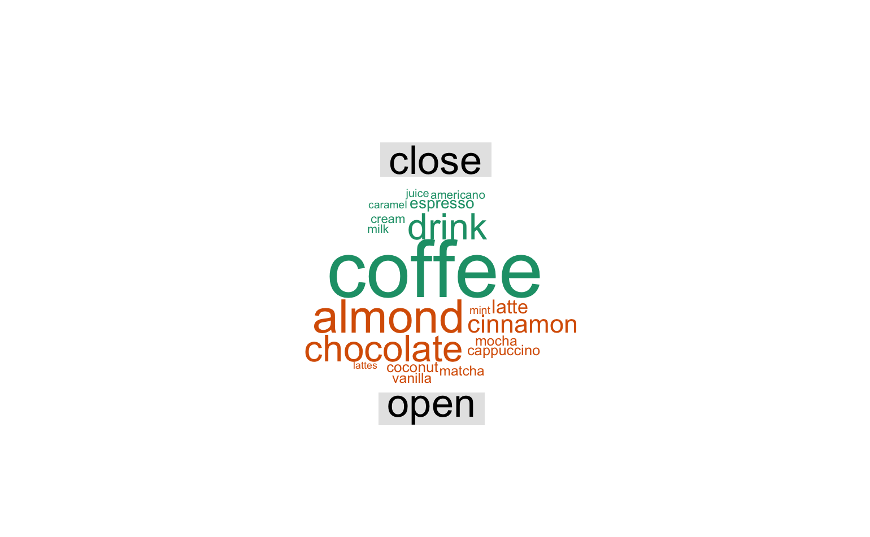
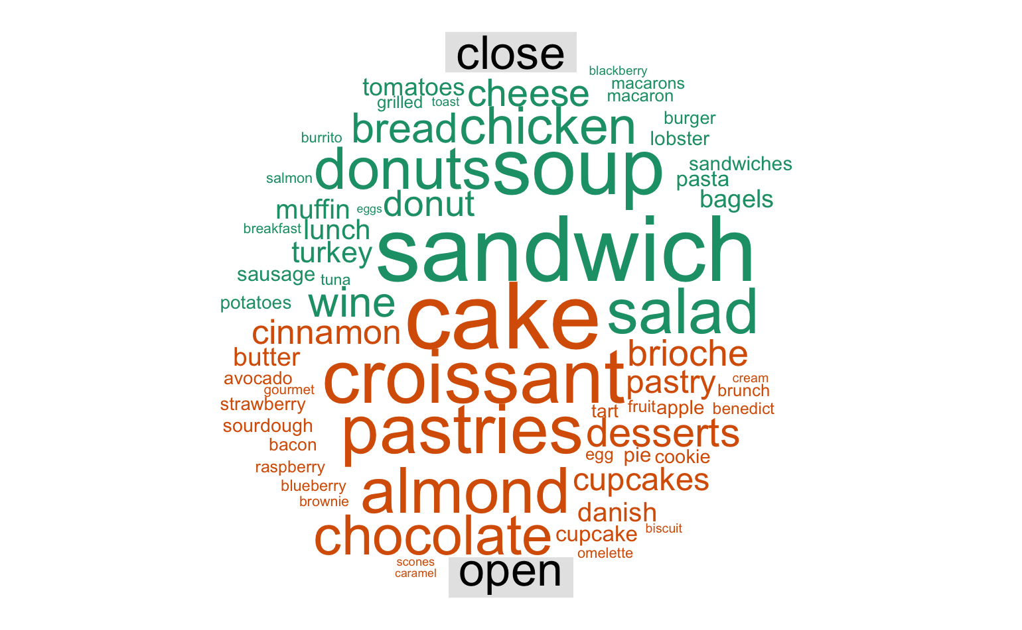
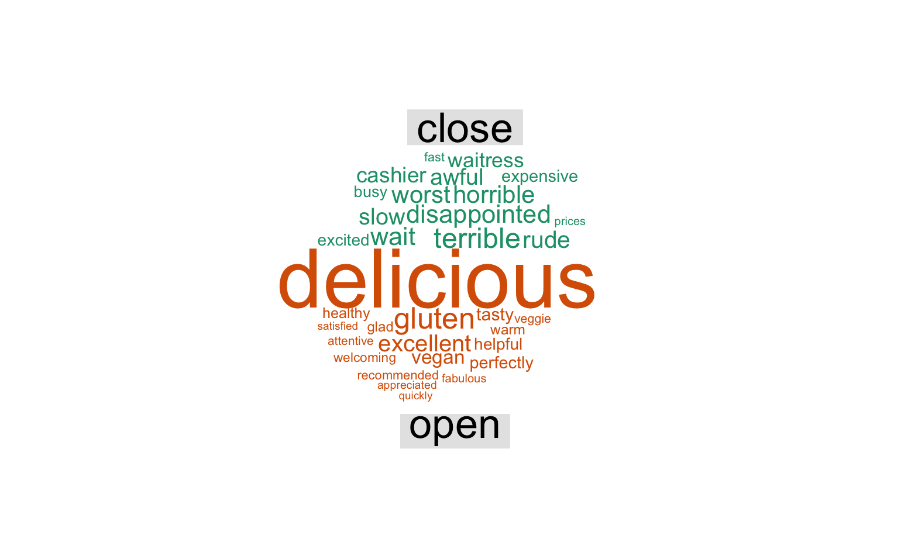
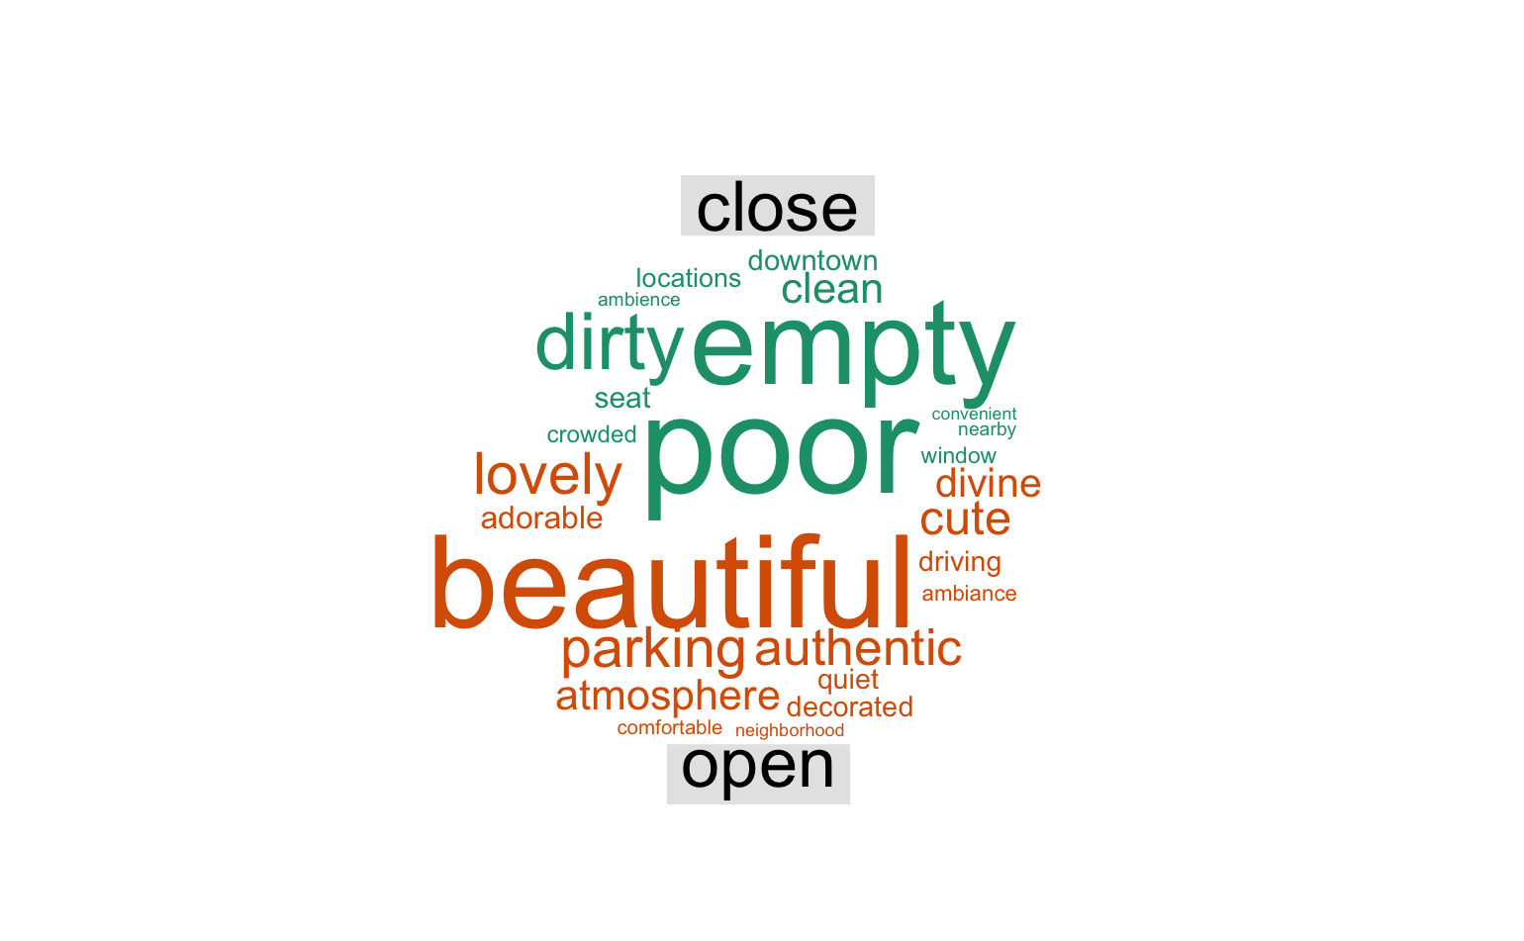
Drinks Food
Suggestions to bakery owners:
Providing more choice on beverages for customers, including more flavors, coffee types and milk options (Drinks)
Try to spend more time making regular pastry food, rather than brunch items (Food)
A comfortable environment and the parking space also help for the survival of bakeries (Ambiance)
Be friendly to customers and don’t let them wait for too long (Service)
Ambiance Service
App Link: https://niharika-chunduru.shinyapps.io/Yelp-Bakeries-Analysis/

Slide 6
Sentiment score analysis
Scores | Label
{score}>=1.5 | The Best!
0.7<{score}<1.5 | Worth a visit
0<{score}<0.7 | Not bad
{score}<0 | Many faults
Sentiment lexicon “afinn”
Calculated sentiment score for each store by their reviews
Labeled each store by their sentiment score
App Link: https://niharika-chunduru.shinyapps.io/Yelp-Bakeries-Analysis/

Slide 7
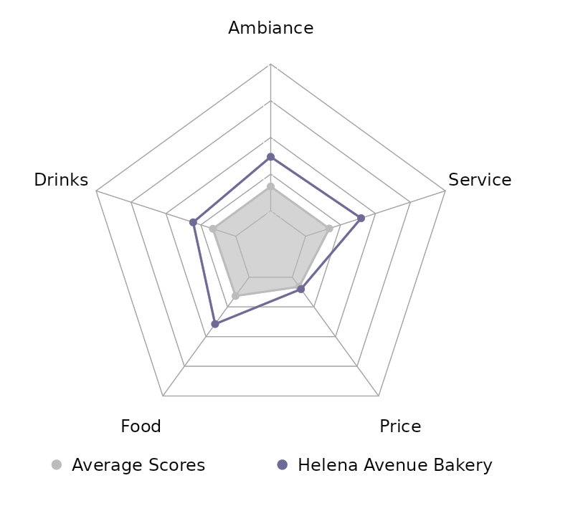
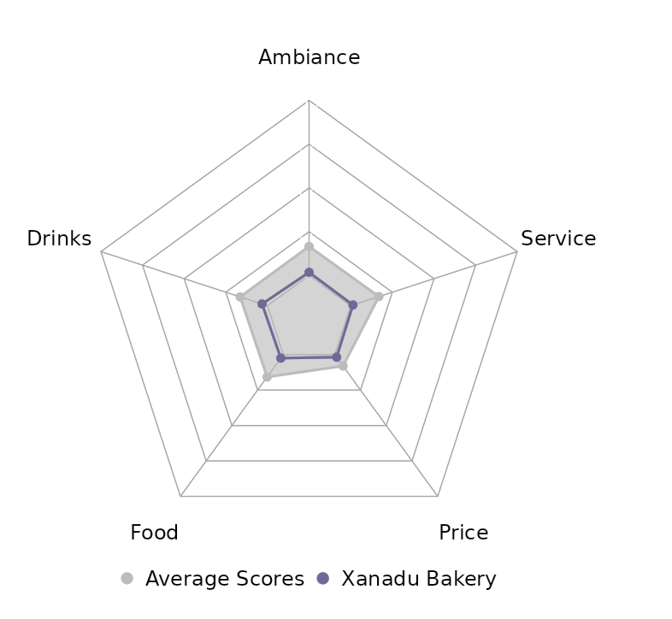
Aspect score analysis
Open Store
Scored the reviews based on top 5 aspect dictionaries
Compared the bakery store scores with the average performance in the county
Separated open and closed bakeries to provide easy comparison
Closed Store
App Link: https://niharika-chunduru.shinyapps.io/Yelp-Bakeries-Analysis/
Notes:
Using the dictionaries for each aspect, we scored the reviews of all bakeries.
We visualized a comparison of the scores of a bakery with a calculated average score in radar plots. T
here are separate plots for open and closed bakeries for easy comparison.

Slide 8
Star ~ {Aspects}
1 Unit change in… | Open Bakeries | Closed Bakeries
Ambiance ↑ | 0.32 ↑ | 0.72 ↑
Drinks ↑ | 0.22 ↑ | 0.70 ↑
Food ↑ | 0.10 ↓ | 0.50 ↑
Price ↑ | 0.10 ↓ | 1.46 ↑
Service ↑ | 0.32 ↑ | 0.08 ↓
Aspects are independent
Aspect score per star-rating for each bakery
Naïve Bayes Classifier with Aspects as features, and Star Rating as the variable
Tells the contribution of each aspect in predicting star rating
App Link: https://niharika-chunduru.shinyapps.io/Yelp-Bakeries-Analysis/
Notes:
All the aspects are independent. So we calculated scores of aspects for each star rating for every store, and fitted it into a Naïve Bayes Classifier to estimate the weight of each aspect. Interesting findings include an increase of 0.3 star rating if open stores focus more on Ambiance and Service, and a 1.46 increase for closed stores if they had more competitive menu prices.

Slide 9
THANK YOU FOR LISTENING!
App Link: https://niharika-chunduru.shinyapps.io/Yelp-Bakeries-Analysis/

